Slide 1
Screening for Chronic Kidney disease
VIGNESHWARAN GIRI VELUMANI

Slide 2
objective
Predict the risk of getting a CKD or the presence of CKD using the given 33 indicator variables
GIVEN
Dataset containing 6000 Records of training data and predict 2819 Records of test data
Target (34th Variable) – CKD : a binomial variable [1,0]

Slide 3
Approach
Remove insignificant variables using Correlation plot
Remove highly correlated variables using VIF
Use the remaining important predictor variables to run a Generalized Linear Model
Remove insignificant variables and run a final Forward Stepwise Logistic Regression using important predictors on training data
Use the same model to predict CKD in test data

Slide 4
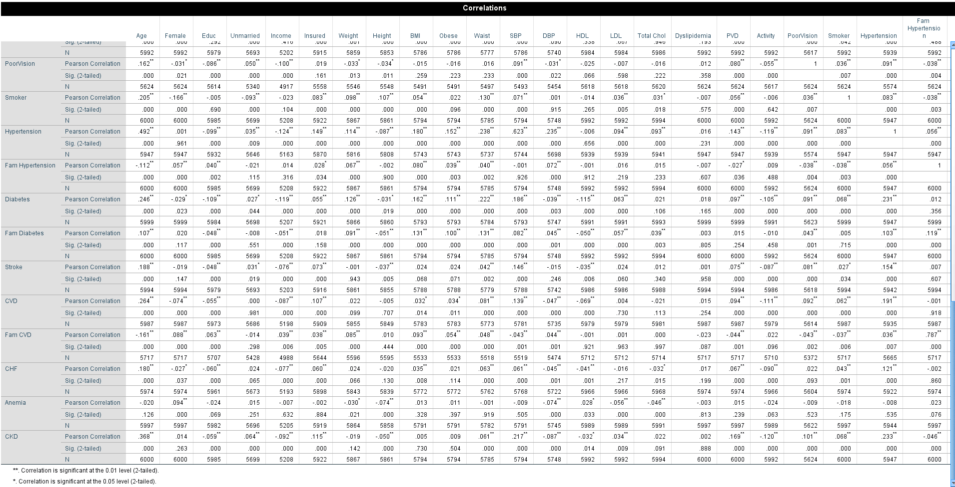
Remove insignificant variables using Correlation plot
Female | Weight | BMI | Obese | Total Chol | Dyslipidemia | Fam Diabetes

Slide 5
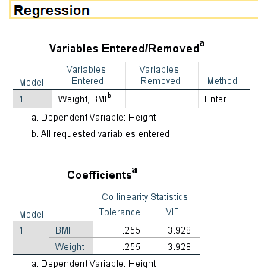
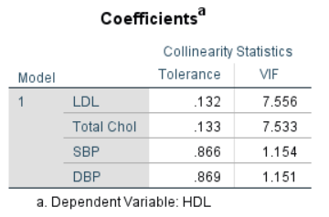
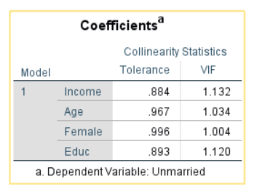
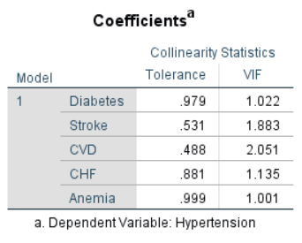
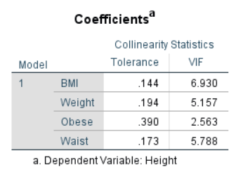
Remove highly correlated variables using VIF
Removed | High Correlation with
Weight & BMI | Height
Total Chol | HDL & LDL
Fam Hypertension | Hypertension
Fam Diabetes | Diabetes
Fam CVD | CVD
Notes:
VIF = measure used to find multicollinearity – if VIF is>5 then remove that variable from the regression model and only use those variables which have VIF<5
VIF = 1/1- R^2

Slide 6
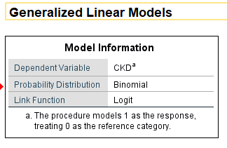
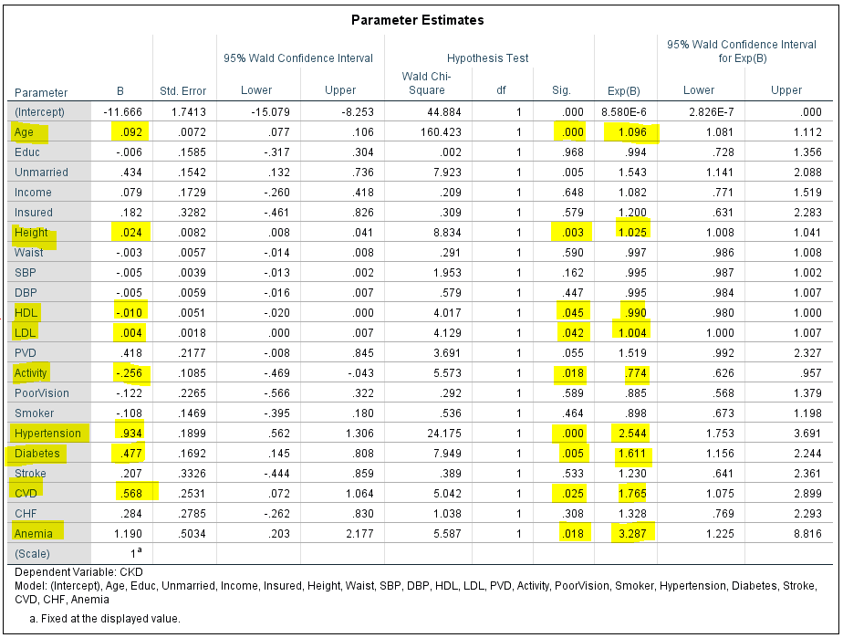
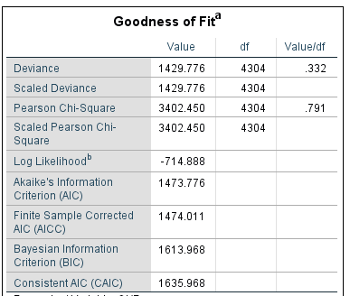
Generalized LINEAR MODEL

Slide 7
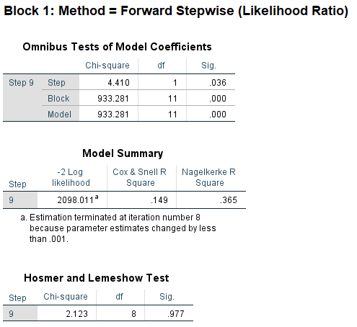
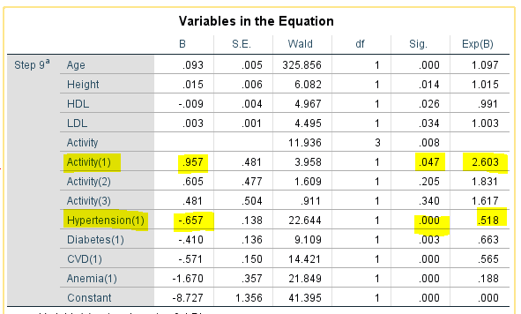
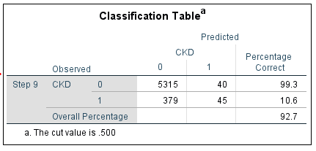
Forward Stepwise Logistic Regression:
The odds of having a CKD is 2.603 times greater for people who Mostly sit as opposed to people who do heavy work/load(4)
The odds of having a CKD is 0.518 times lesser for people who do not have hypertension as opposed to people who do.
The odds of having a CKD is 0.663 times lesser for people who do not have diabetes as opposed to people who do.
The odds of having a CKD is 0.565 times lesser for people who do not have CVD as opposed to people who do.

Slide 8
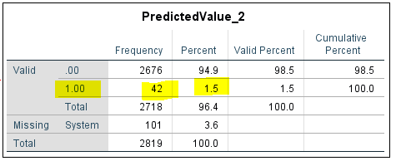
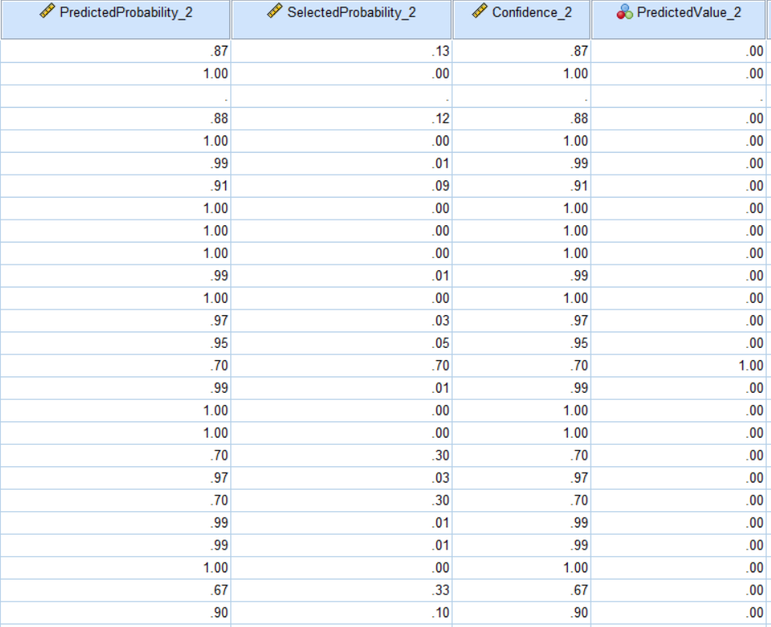
PREDICTION IN TEST DATA:
The model has predicted 42 patients having the risk of presence of a CKD which is 1.5% of the test data population

